Slide 1
Human-Centered Artificial Intelligence (HCAI)
Kick-off
Responsible Lecturer: Bram Heijligers

Slide 2
We live in the “Information” or “Digital” age
Which is characterized by the rapid development and widespread use of information and communication technologies...

Slide 3

Meanwhile, world is quite complex, and keeps getting more complex
More things to do, to remember, to process, to communicate...

Slide 4
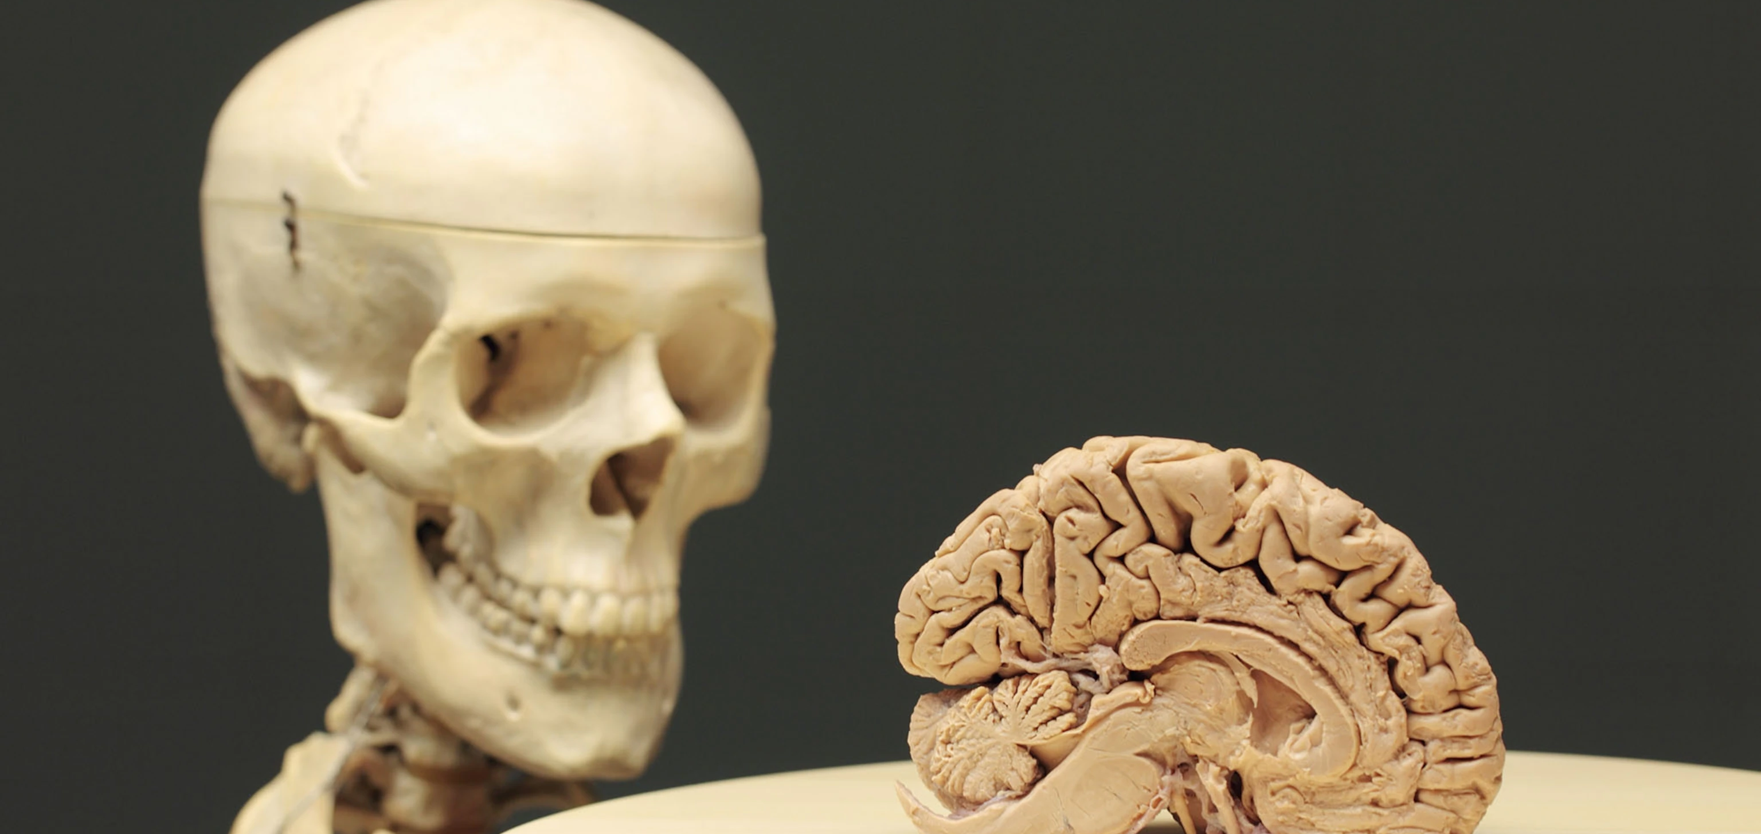
The human mind is very limited
Working memory, conscious capacity, subconscious capacity, vulnerable to environment, dependent on energy level, etc...

Slide 5

How can we deal with these limitations?

Slide 6


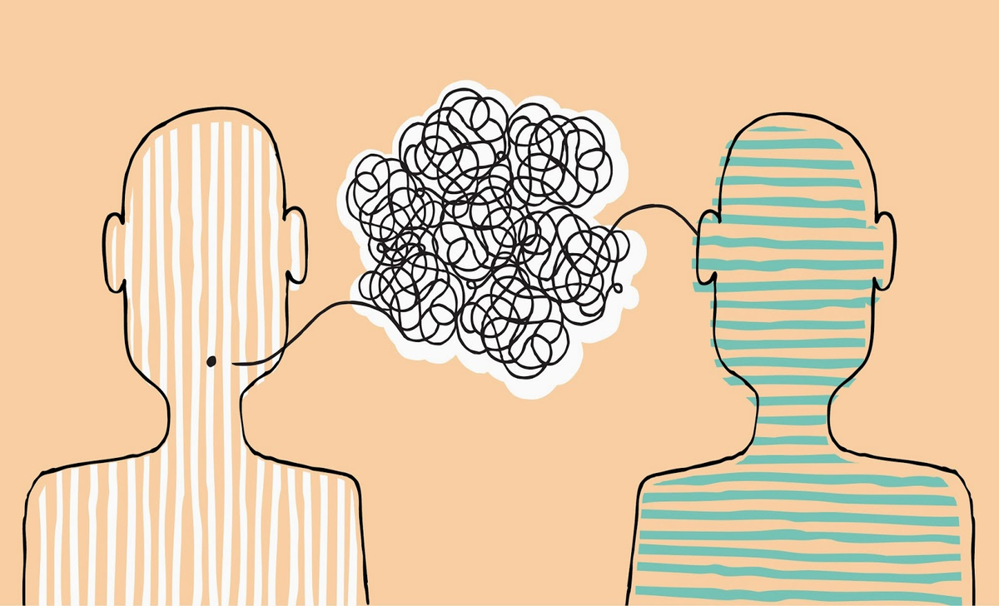

We can store information in our environment...

Slide 7
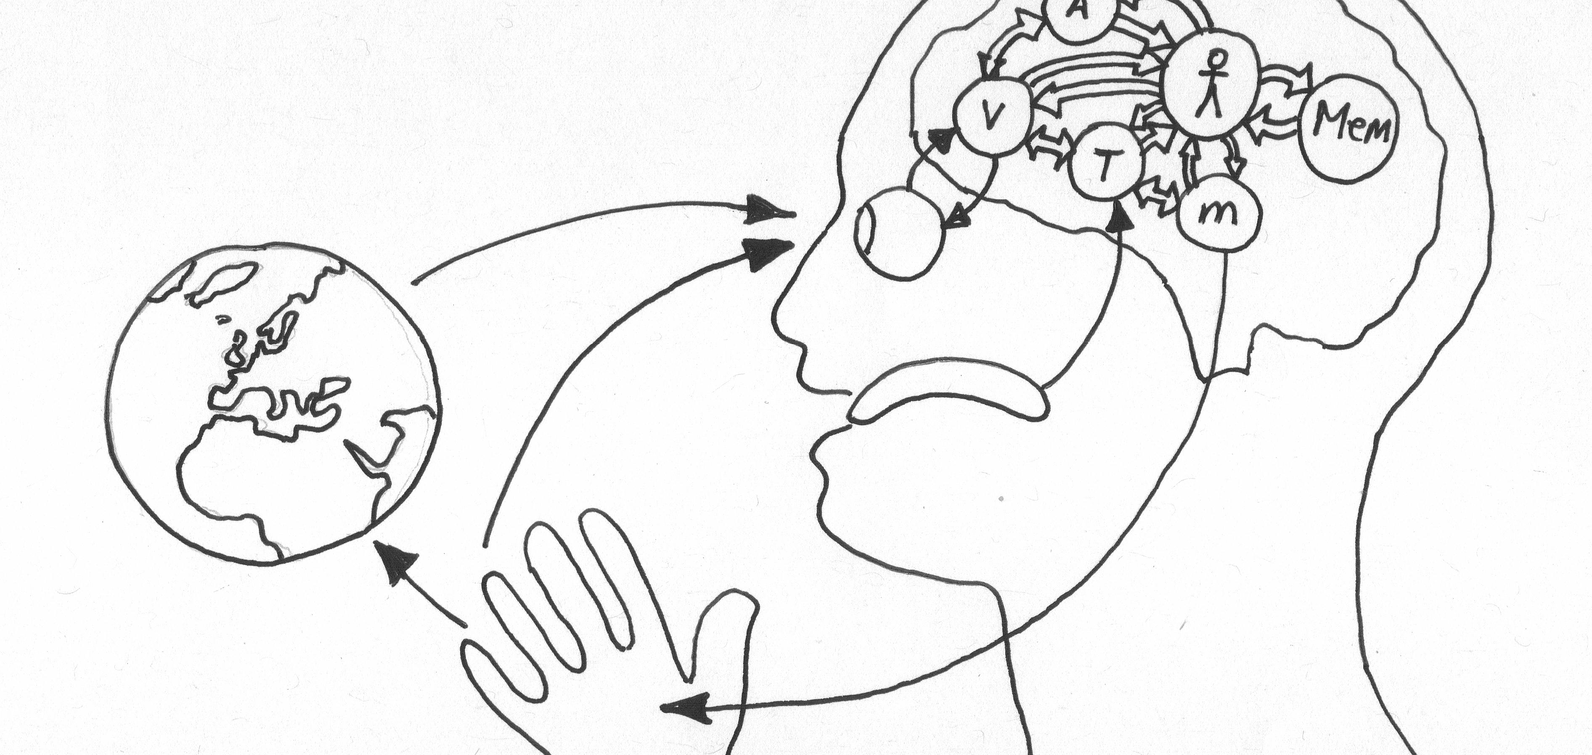
This is called, the extended mind theory
It made people more efficient and drives our civilisation!
Computers are merely the next step; processing instead of just storing!

Slide 8
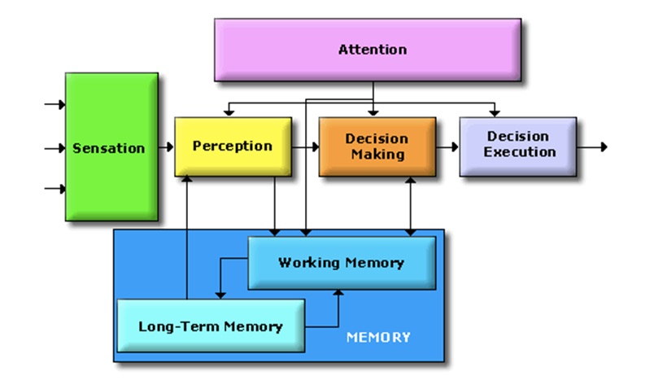
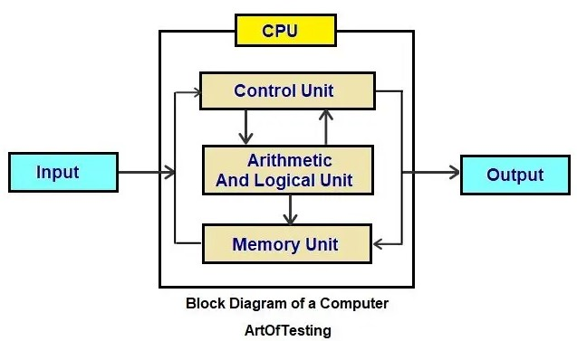
Computers: adding processing besides memory capacity to our ‘cognition’
Human Cognitive System
Computational System
Info/Controls
Info/Behaviour
Environment
/
Communication Medium
(e.g. Display, speakers)
Info/Controls
Info/Controls

Slide 9

Driven by competitive pressure, humans are driven to become more efficient...

Slide 10
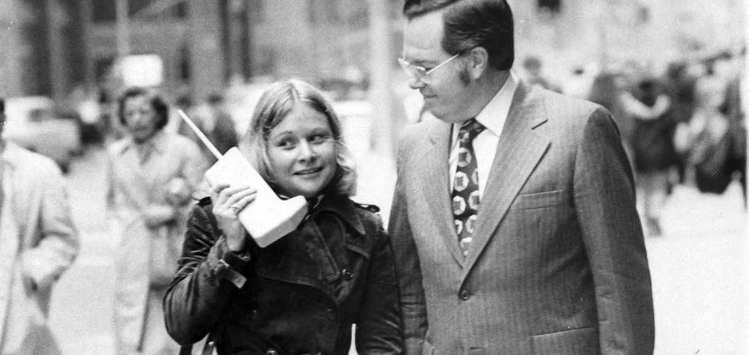
Initially, people thought cellphones would horribly invasive...
But... They make people more efficient and competitive...
So people adopted them in order to remain competitive

Slide 11
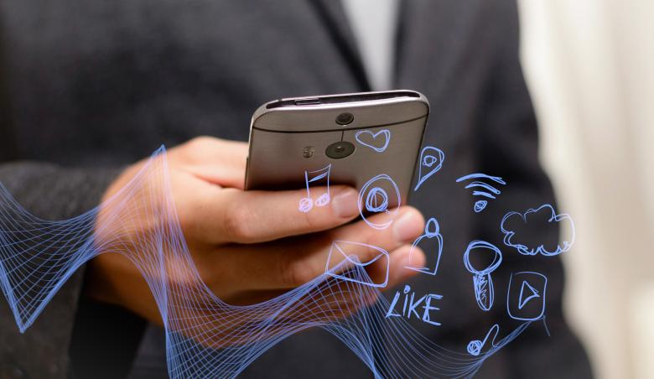
Now we live in an interconnected world
Cognitive processes are coupled online, for example:
You can send messages
Other people interacting with search engines improve your access to information
Information is processed automatically
E.g. If you upload new photos to a photo database like Google Photos, it automatically starts organizing these
Results are pushed to us by our applications
New message
Weather/News
Advertisements based on web interaction

Slide 12
This interconnected world of information processing is called: the Network-enabled cognition theory

Slide 13
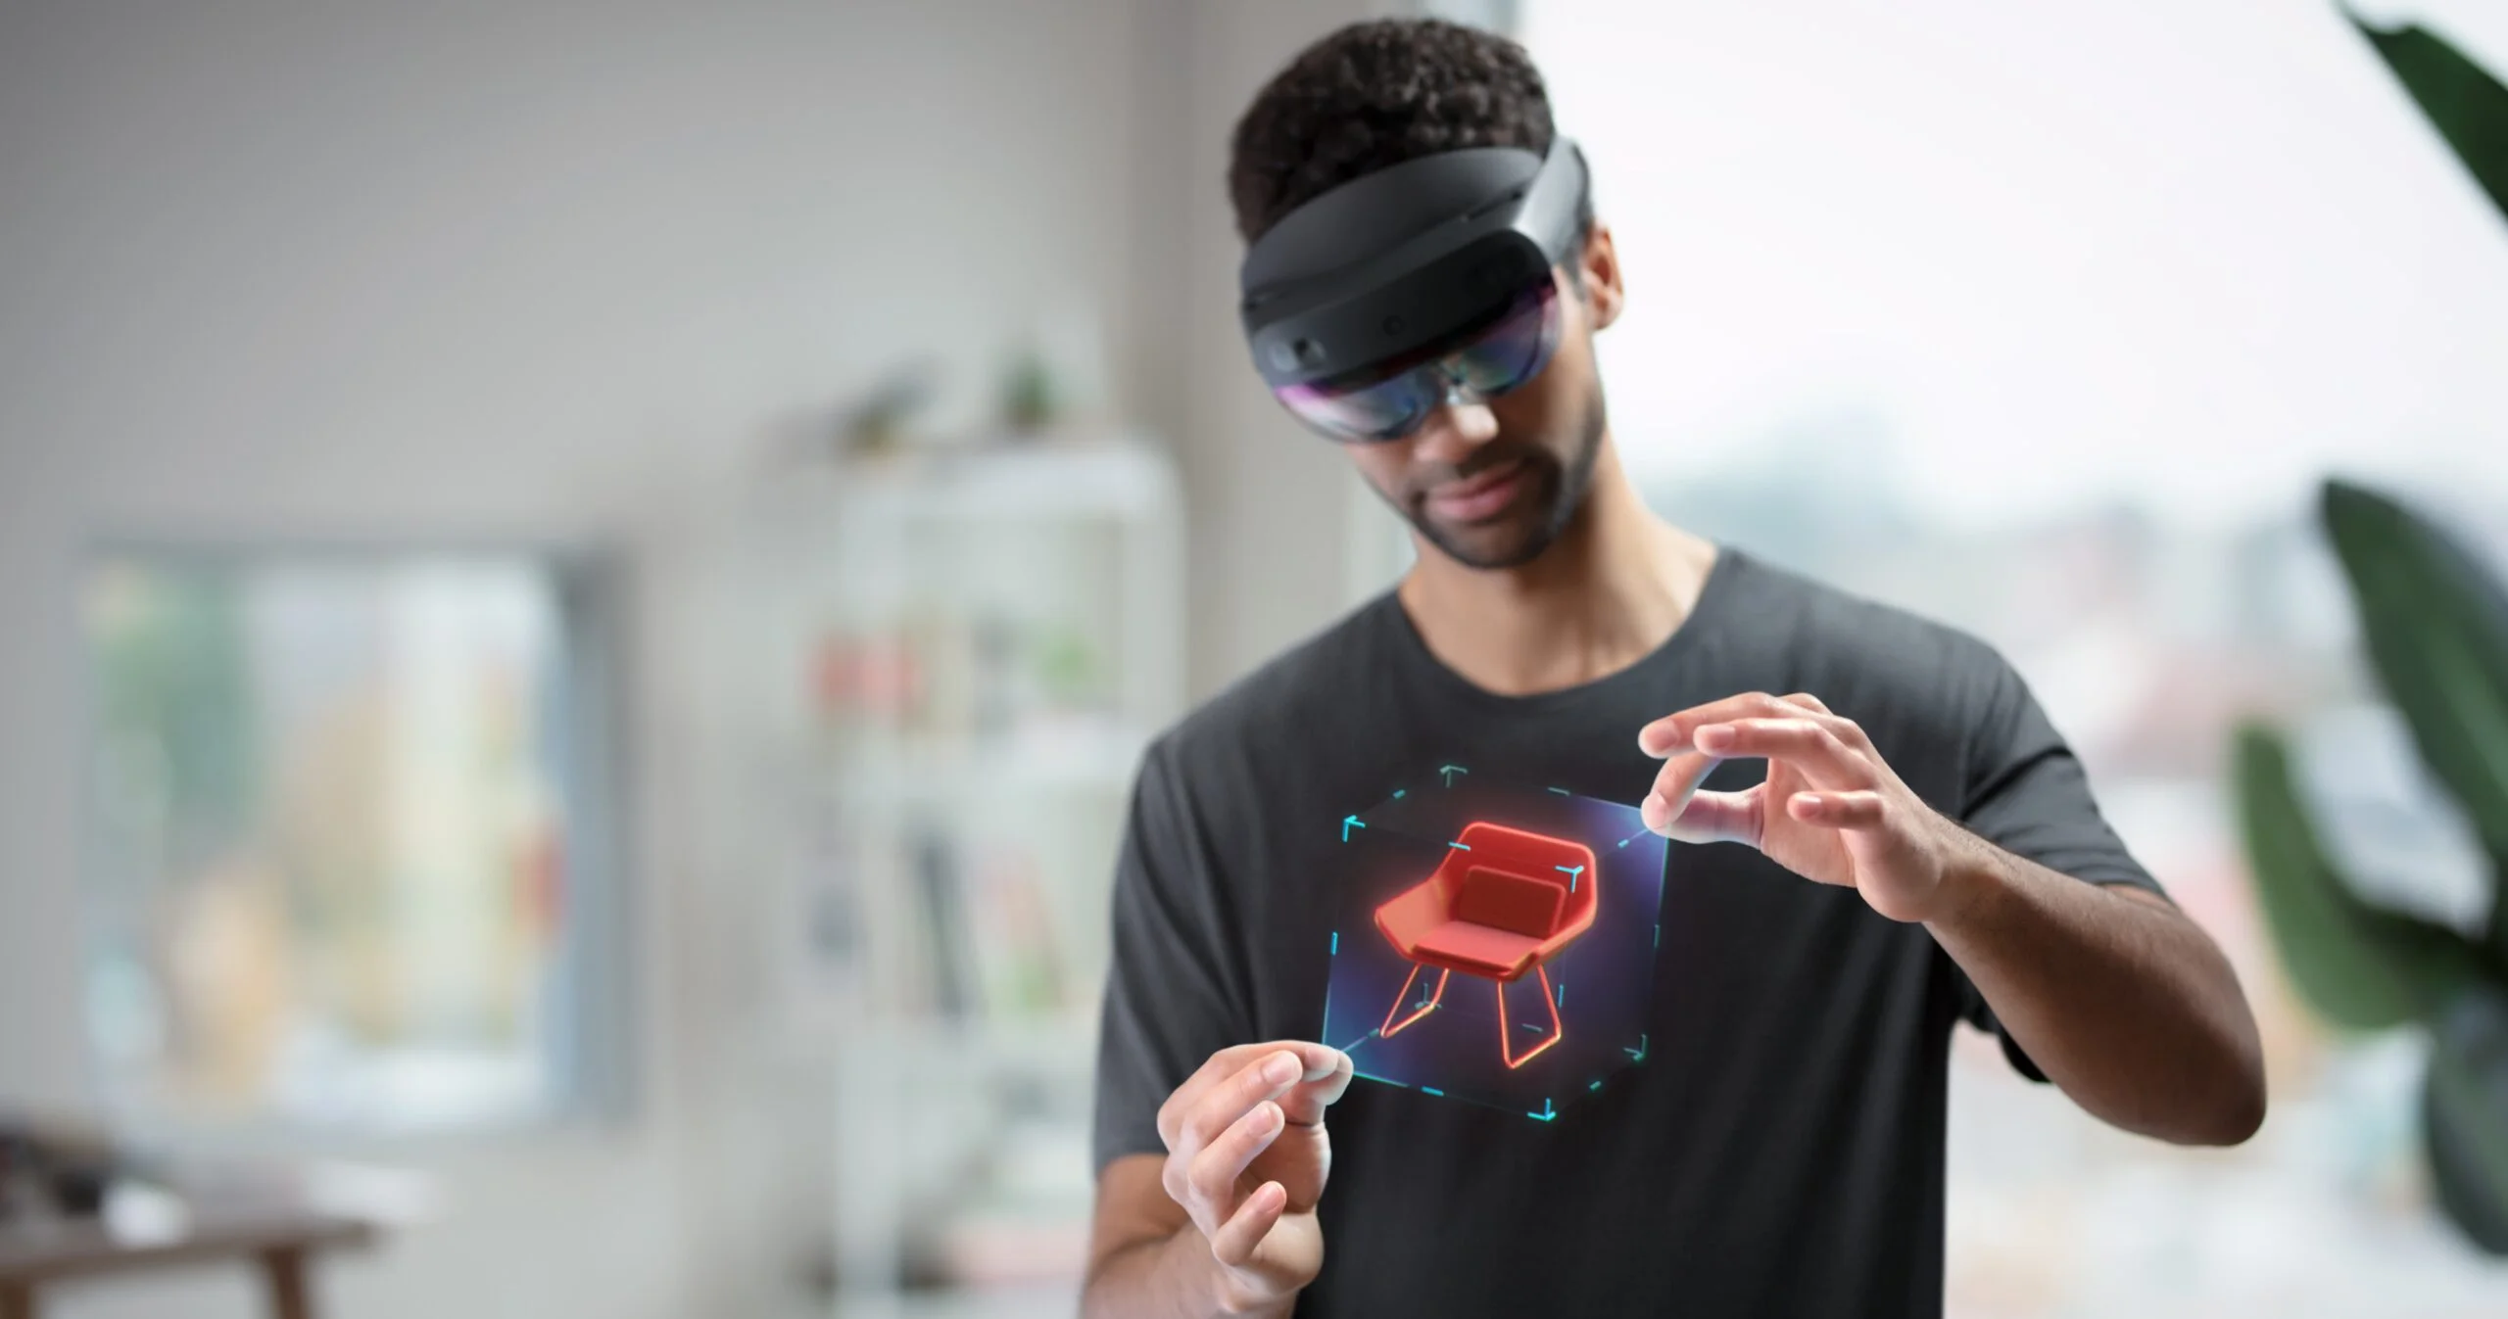

And it’s not going to stop soon, in fact, it’s going to speed up...
A prediction which came true...
But, it’s going to become more intuitive; more like real-life
Thoughts? Questions?

Slide 14
Human-Centered Artificial Intelligence
And now, computer applications are going to react (quasi) intelligently to us instead of just processing information...

Slide 15

What are we going to learn?
Designing Human-centered AI applications
Specifically, you will learn how to create basic prototypes by:
understanding and applying the basic design principles of user-experience design;
understanding and apply the basic processes of user-experience design;
understanding and embedding algorithms and analyses into an application;
in the context of artificial intelligence.

Slide 16

Why are we going to learn it?
Algorithms and models by themselves cannot immediately add value to consumer and business processes; to the real-world
Adding value can be done by:
a human interpreter: analysing, collecting data, scripting, designing etc.;
embedding them in an application which automates these processes.
Possible applications of AI and real-world change are different things...
Therefore, we need to start from human perspective;
AI is helping humans: making choices with the user always at the center of the design, development and interaction process.
This means focussing on needs and context of the users in order to achieve better results when it comes to the fit of a technical system in people’s everyday lives.
→ NN were there in 1980’s but not feasibly applicable

Slide 17

How are we going to learn it?
By:
developing a wireframe prototype using various iterative testing methodologies, design techniques and processes;
explicitly involving stakeholders in the design and testing of application (prototype);
creating a remote user test from your wireframe prototype;
designing an appropriate user experience to facilitate artificial intelligence/data science applications;
designing for and communicating about various disruptive technology risks;
justifying design decisions using basic design principles of user-experience design;
designing for continuous learning of our AI algorithms.

Slide 18
What are you going to deliver?
A live demo (online or offline) of the wireframe prototype to convey your application design where the lecturers will act as the client for the final presentation. The wireframe will be assessed on the user-experience, continuous learning; and therefore the value created by the app.
User-experience defined as:
Interaction flow;
Interaction quality;
Intuitive user understanding (of presented data & interactions).
Value defined as:
Client appreciation;
Useful features;
Holistically effective for the target audience;
The value of the data analysis to the features;
Effective embedding of continuous learning;
Management of disruptive technology risks.

Slide 19

Okay...
But what does that mean for me concretely?
A live demo of what?
How does that look like?

Slide 20
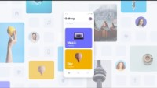
Like this:
We’ll use Proto.io
It’s like an interactive powerpoint
You can click on it
Add audio, effects, movies etc.
You can share it online
Collect data
It’s easy to use and let’s you test and play with different designs before building the real-deal

Slide 21
Student examples from last year
Student App X Student App Y

Slide 22


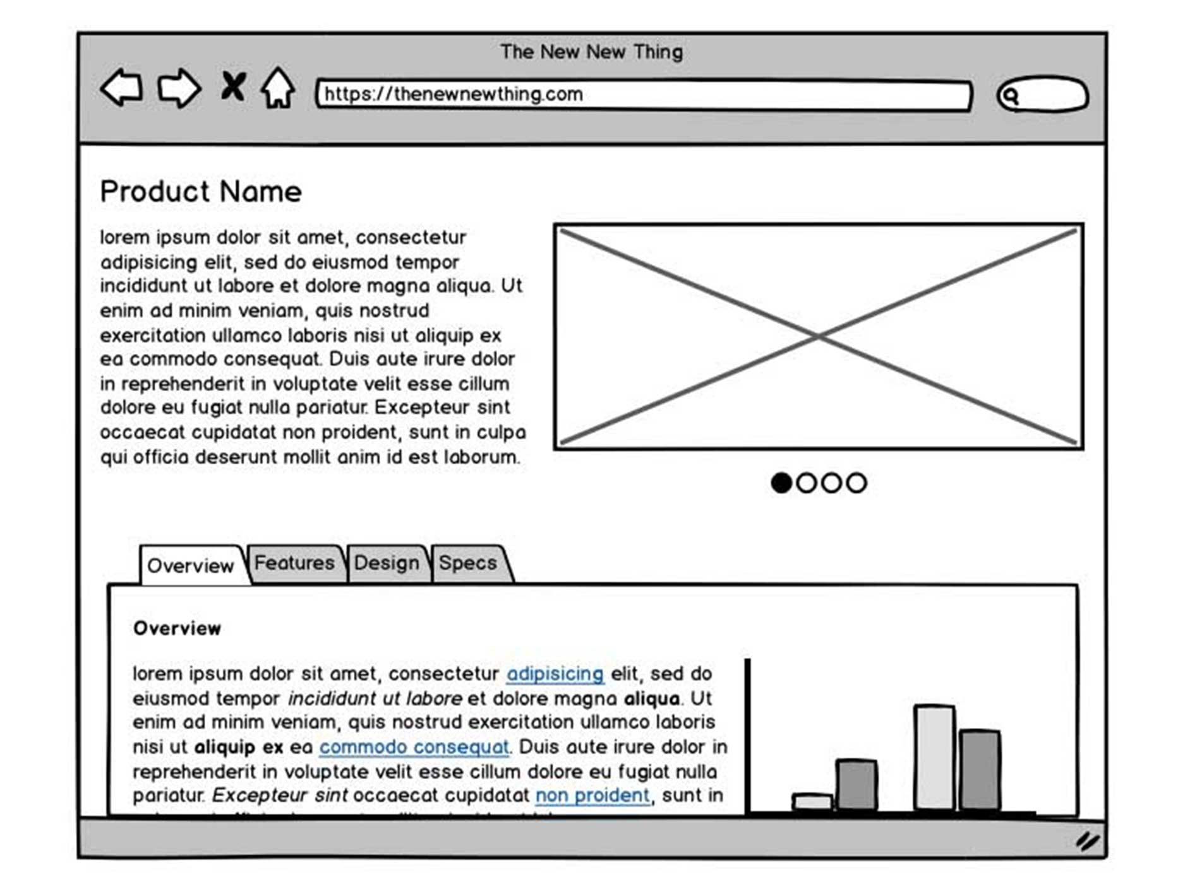
We’ll get hands-on in tomorrow’s self-study day, and work with proto.io from there onwards!
To use proto.io, create an account and use the free 14-day trail!
What if you want to use another type of software?
E.g. Adobe XD, Marvel, Balsamic. → Fine as well!

Slide 23
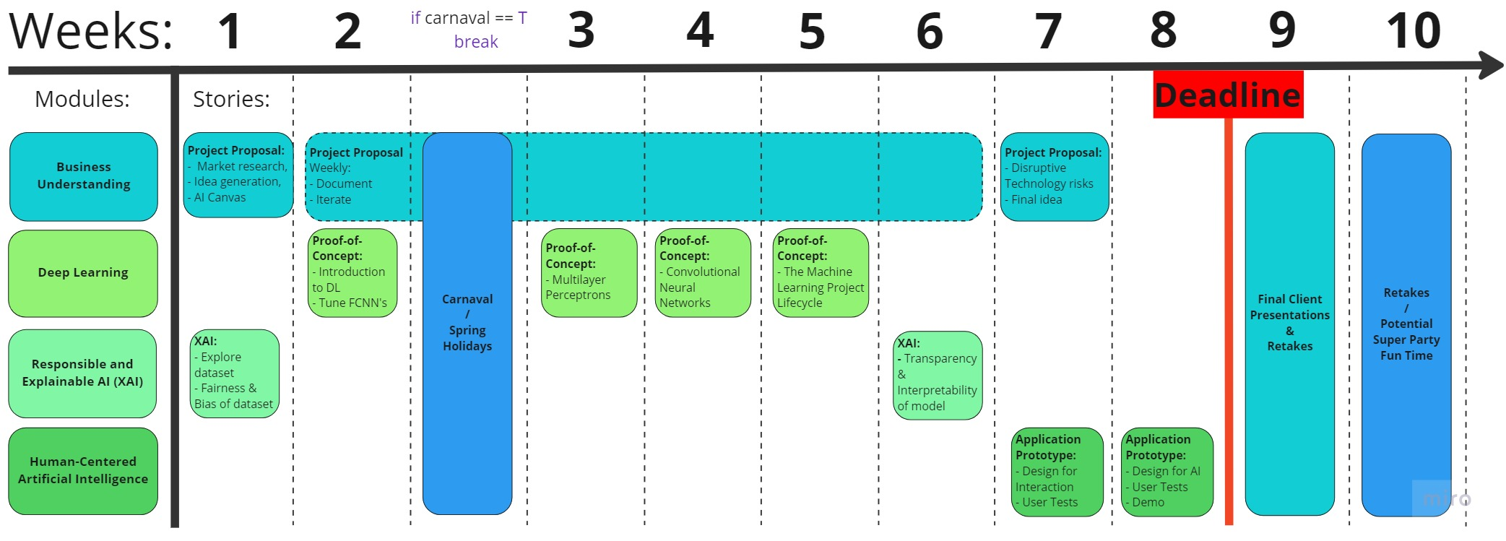
Where are we now with the creative brief?

Slide 24
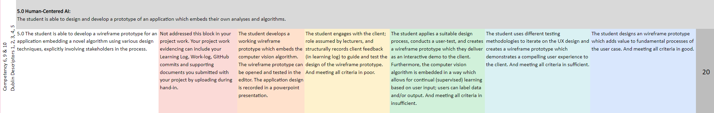
How are you going to be assessed?
Designing Human-centered AI applications
Operationalized for assessment in:
ILO 5. Design, Prototyping and Implementation:
The student can develop a wireframe prototype for an application embedding a novel algorithm using various design techniques, iteratively testing his design and explicitly involving stakeholders in the process.
Exact mapping → Project Proposal Template

Slide 25
Practical Information
Module Structure:
High-Level (or general) design
Specific design surrounding CV
User test → Iterate
Low-Level (Detailled) design
Disruptive Tech Risks
User test → Iterate
Finalize design
Communicate → Final presentation
The stand-ups will revolve around the preparation for the data labs and learning objectives of the self-study days.​
Community learning – ask your peers!​
If topics are still unclear, please contact me in the Q&A channel on MS Teams!
!!DataLab days require preparation!!​
!!DataLab days require preparation!!​
!!DataLab days require preparation!!​
!!DataLab days require preparation!!​

Slide 26
Any Questions?
Let’s get started

